Slide 1
Marginal workers in tamilnadu

Slide 2
What is marginal workers?
Marginal jobs are defined as those that are unstable, intermittent, or in other ways outside the economic jobs, even if they do not share the mainstream. Persons who hold these personal characteristics of marginal workers, are ex- pected to be underutilized.

Slide 3
Working days for marginal works
According to economic status, population in India is divided into: (a) Main workers: a person who works for at least 183 days in a year. (b) Marginal workers: who works for less than 183 days or 6 months in a year.

Slide 4
Percentage of marginal workers in tamilnadu
A. In Census 2011, out of 32.9 million total workers, 27.9 million are main workers and the remaining 4.9 million are marginal workers. The percentage of main workers among the total workers, in Census 2011, is 85.0% against 85.2% in Census 2001.

Slide 5
Difference between main workers and marginal workers
Main Worker is a person who works in any economically productive activity for at least 183 days (or six months) in a year. Marginal Worker is a person who works in any economic activity for less than 183 days (or six months) in a year.

Slide 6
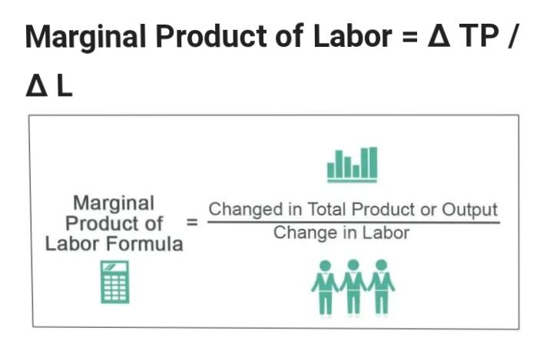
How to calculate marginal workers

Slide 7
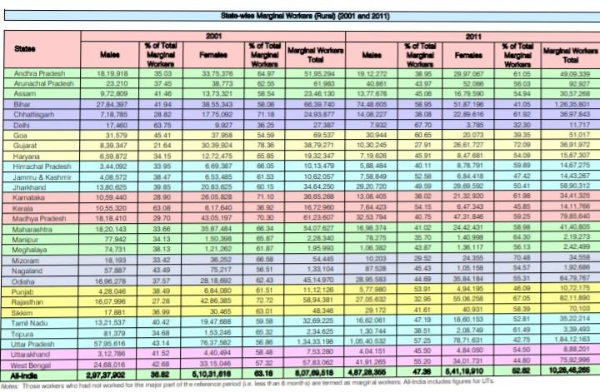
Statewide marginal workers in india

Slide 8
Benefits of marginal workers
Marginal workers are entitled to their (state) pension payments, or to unemployment benefits (and unemployment assistance), if eligible.
For example: Let’s say a pair of shoes are being sold for $40. However, a consumer is willing to pay $50 for the pair. The marginal benefit would then be $50. This means the marginal benefit is higher than the actual price of the shoe by $10.

Slide 9
